Slide 1
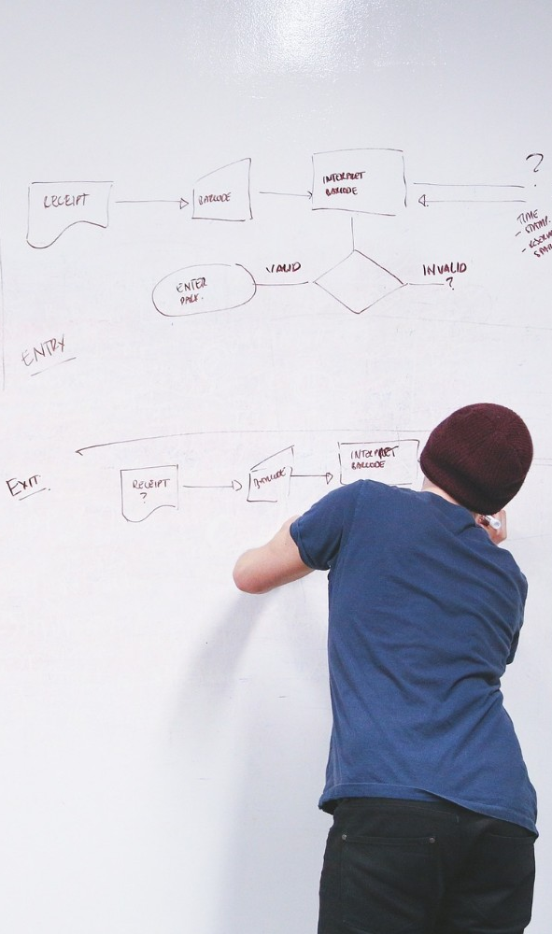
Problem Statement:
Design a website or mobile app using HERE Location Services and Mobile SDKs that offers guided tours,historical information ,and interactive maps for tourists exploring a city.

Slide 2
Travel Gen website:
This website works for tourists ,it will help users for searching desired place lacation in india ,here users can sign in ,and gain knowledge about the desired historical places in india .This website provides them information about desired historical place .It will provide location ,from their home location or anywhere to the desired place.

Slide 3

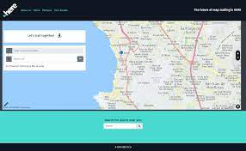
Technology that are used in:
”

